Slide 1


23 & Me Variant Analysis
APOE-C130R / APOE-E4
Eliot Kmiec

Slide 2

Overview:
APOE Gene
Physiology of APOE
Alzheimer’s Risk & APOE Variants
Pathophysiology
Prognosis

Slide 3

APOE
Located on chromosome 19
317 residues (299 in mature form)
405 variants recorded in Uniprot¹
Major Allele Frequencies⁵:
E4 ~14%, E3 ~79%, E2 ~7%
Important Domains^{7,8}:
LDL Binding Site
Receptor Binding Site
Signal Peptide

Slide 4

Physiology
Initiates formation of HDL
Transports cholesterol
Maintains lipid homeostasis^{7,8}
Promotes cellular uptake of cholesterol / neuronal growth & repair³

Slide 5
APOE-C130R / APOE-E4
Cysteine for Arginine substitution¹
Demonstrated to bind beta-amyloid fibrils more readily than WT variant (E3)⁴
Increased risk of Alzheimer’s compared to general population³

Slide 6
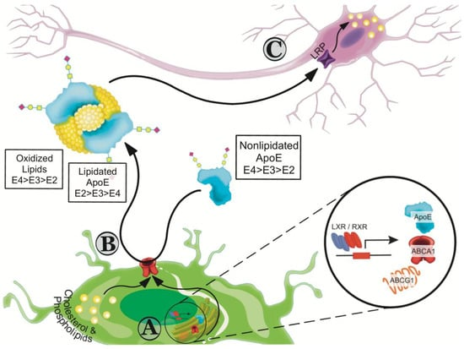
Pathophysiology of Alzheimer’s
Beta-Amyloid plaque deposits
Formed by Tau proteins
Initially target Hippocampus
Short-term memory loss usually first sign of dementia onset ^{3,5}
Figure 1: (Lanfranco et al 2020)

Slide 7
Prognosis
Treatment of Alzheimer’s mostly supportive – some drugs can slow cognitive decline⁶
Pt is homozygous E4 – high genetic risk⁴
Most E4 carriers still do not develop Alzheimer’s⁴

Slide 8

End of Life Care Conversation

Slide 9
References
(1) Uniprot/Swiss-Prot, Apolipoprotein E, APOE, P02649 (Accessed 11/30/2023)
https://www.uniprot.org/uniprotkb/P02649/entry
(2) Clinvar: RCV001195807.10 (Accessed 11/30/2023)
https://www.ncbi.nlm.nih.gov/clinvar/RCV001195807.1/
(3) Forero, DA, López-León, S, González-Giraldo, Y, Dries, DR, Pereira-Morales, AJ, Jiménez, KM, Franco-Restrepo, JE. 2018. APOE Gene and Neuropsychiatric Disorders and Endophenotypes: A Comprehensive Review. Am J Med Genet Part B 177B: 126–142.
(4) OMIM, 107741, Apolipoprotein E; APOE (Accessed 11/30/2023)
https://www.omim.org/entry/107741?search=APOE&highlight=apoe
(5) Lanfranco, M.F.; Ng, C.A.; Rebeck, G.W. ApoE Lipidation as a Therapeutic Target in Alzheimer’s Disease. Int. J. Mol. Sci. 2020, 21, 6336. https://doi.org/10.3390/ijms21176336
(6) Mayo Clinic, Alzheimer’s Disease (Accessed: 11/30/2023)
https://www.mayoclinic.org/diseases-conditions/alzheimers-disease/diagnosis-treatment/drc-20350453
(7) Zannis VI, McPherson J, Goldberger G, Karathanasis SK, Breslow JL. Synthesis, intracellular processing, and signal peptide of human apolipoprotein E. J Biol Chem. 1984 May 10;259(9):5495-9. PMID: 6325438.
(8) Paik YK, Chang DJ, Reardon CA, Davies GE, Mahley RW, Taylor JM. Nucleotide sequence and structure of the human apolipoprotein E gene. Proc Natl Acad Sci U S A. 1985 May;82(10):3445-9. doi: 10.1073/pnas.82.10.3445. PMID: 2987927; PMCID: PMC397792.

